Slide 1
AI in Teaching:
Recommendations for Students

Slide 2
How does ChatGPT work?
Bevor using ChatGPT (https://chat.openai.com/), we strongly recommend that you research the underlying technology/statistics, to get an idea of how ChatGPT works.
For this, we recommend an online presentation by Prof. Dr. Doris Wessels (FH Kiel; in German but subtitles can be adapted): https://www.youtube.com/watch?v=cMuBo_rH15c

Slide 3
Respect the law and regulations given by your institution
You have to respect relevant national or regional/university-specific legislation and (examination) regulations.
You must follow the rules regarding quotations and good scientific practice.

Slide 4
Reflect your learning goals
Higher education is more than discipline-specific learning goals. AI increases the need for critical as well as structural thinking to evaluate information, ideas, and arguments systematically and rationally skills that can be trained by yourself using AI tools such as ChatGPT.
Increase your individual prompt engineering skills to benefit most of AI assistance.
Depending on learning goals, you should reflect and determine for which goals / learning steps you can benefit from using AI tools to best supplement and enhance your learning experience.

Slide 5
Use ChatGPT as a writing partner
ChatGPT should never be the sole author as the created content might be false or meaningless and is not up to date (any references given might also be wrong). Thus, you should adhere to the principles of good scientific practice have a basic understanding of a topic and the limitations of the technology.
Ideas on how to use ChatGPT as a writing partner:
  generating a headline for an essay
  summarizing
  paraphrasing (but please be aware that paraphrasing texts written by others and submit it as your own writing is considered plagiarism)
  spelling and grammar correction
  proofreading and editing (with focus on language)

Slide 6
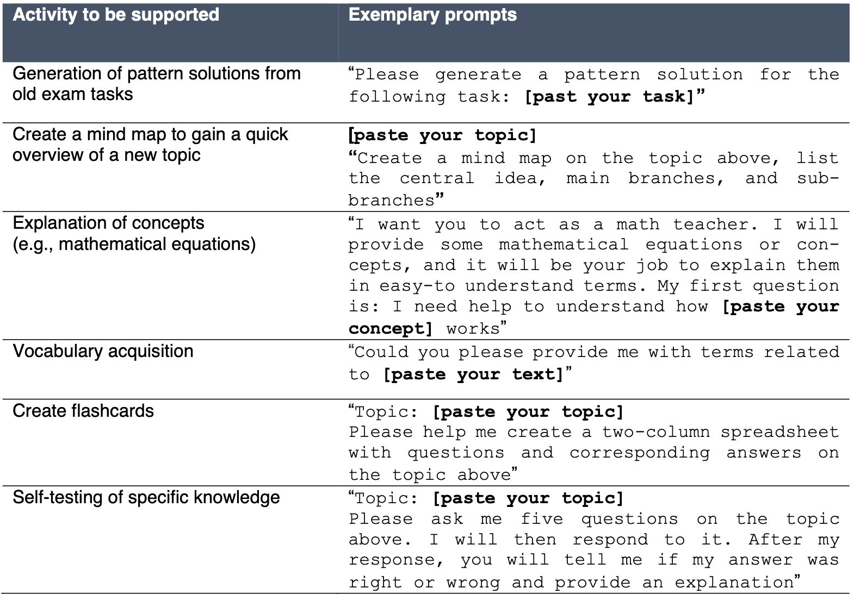
Use ChatGPT as a learning partner

Slide 7
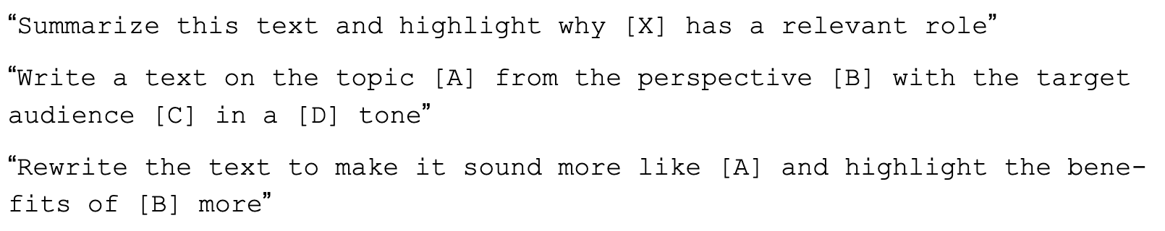
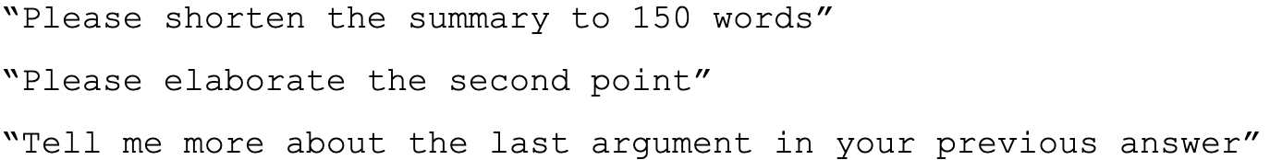
Improve your outputs
To benefit most from the generated output, it is crucial to provide accurate and specific information. If text results are not satisfying yet, you can request more information and provide detailed feedback to improve the model's responses by the following example principles:
Alternatively, the "Regenerate Response" function can be used by, e.g.

Slide 8
Summarize your learning material with ChatGPT
Multiple plugins exist to summarize video transcripts (e.g. from youtube videos) to support learning outcomes and saving time.

Slide 9
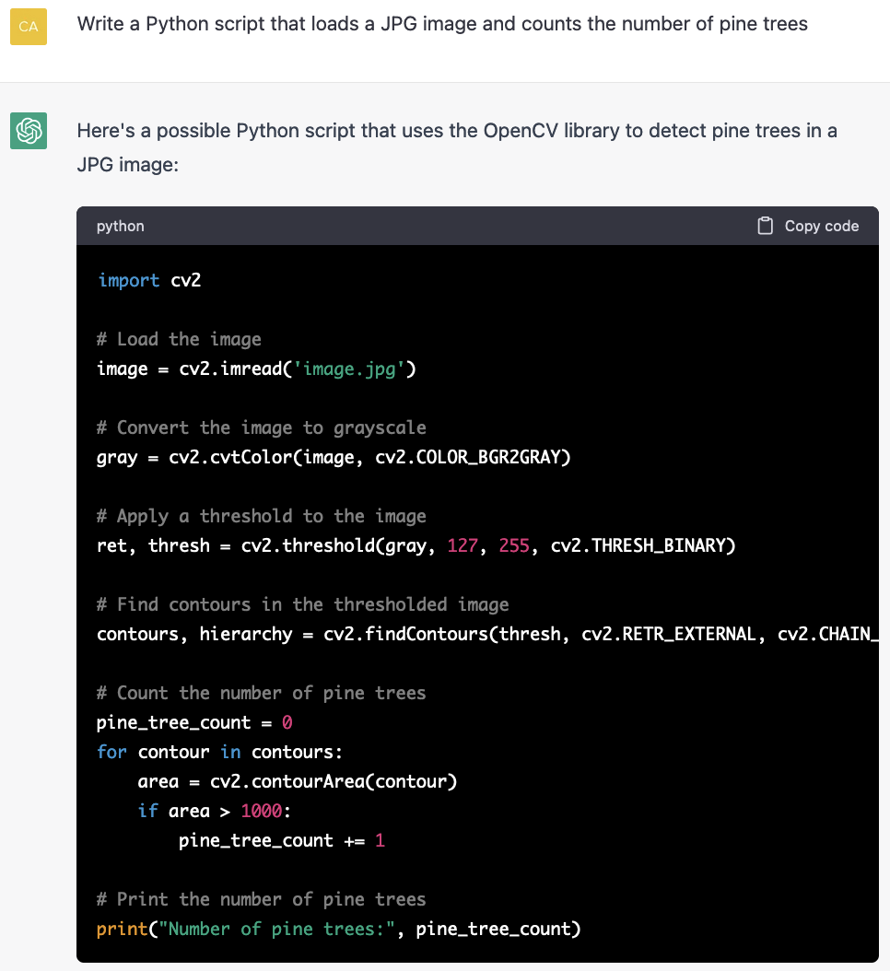
Boost your coding with ChatGPT
With the right prompt, ChatGPT can give suggestions on coding.

Slide 10
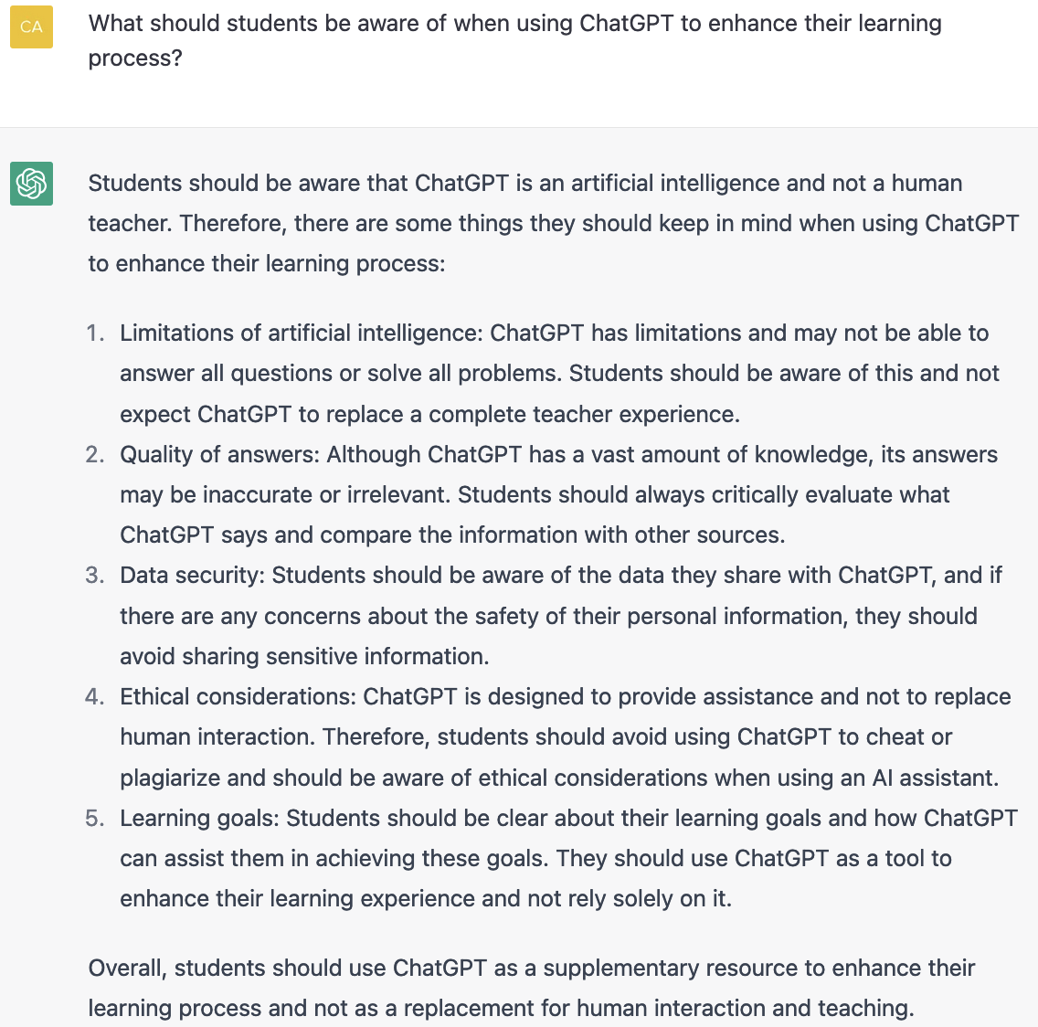
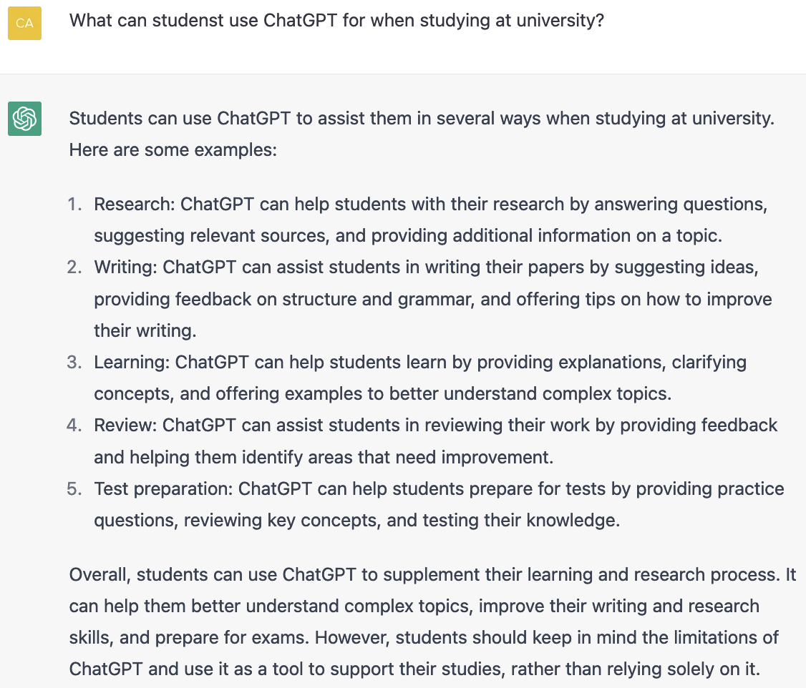
Why not asking ChatGPT itself…
But…
https://chat.openai.com/chat, 22.03.2023

Slide 11
References
Gimpel, H. et al. (2023) Unlocking the Power of Generative AI Models and Systems such as GPT-4 and ChatGPT for Higher Education. A Guide for Students and Lecturers. https://digital.uni-hohenheim.de/fileadmin/einrichtungen/digital/Generative_AI_and_ChatGPT_in_Higher_Education.pdf

